Slide 1
Measurement of angular displacement and angular velocity
Tachometer
Potentiometer
Optical encoders
Resolver

Slide 2
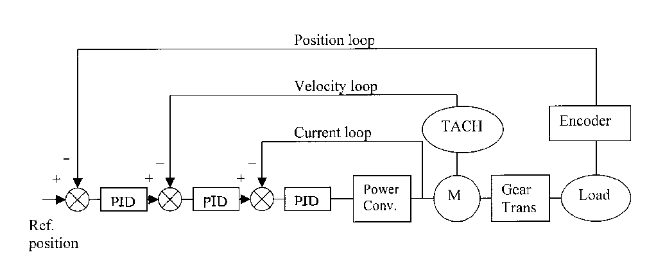

Slide 3
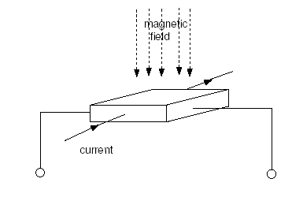
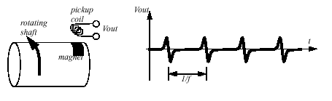
Tachometer: (Hall effect sensor based) velocity sensor
Hall Effect Sensor: When a magnetic field is applied to a conductor
with current flowing through it, a voltage drop across the conductor is generated.
When the time between the pulses is measured the period for one rotation can be found, and the frequency calculated. This technique often requires some signal conditioning circuitry.

Slide 4
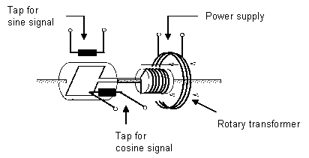
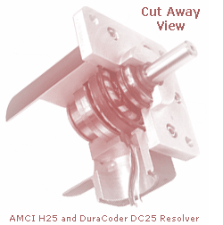
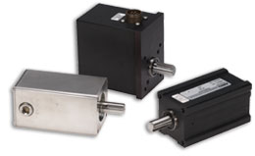
Resolvers
What is a resolver?
A resolver is a position sensor or transducer which measures the instantaneous angular position of the rotating shaft to which it is attached.

Slide 5
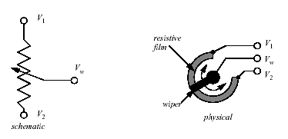
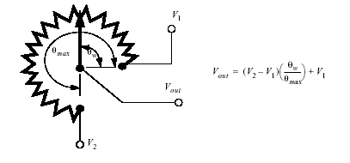
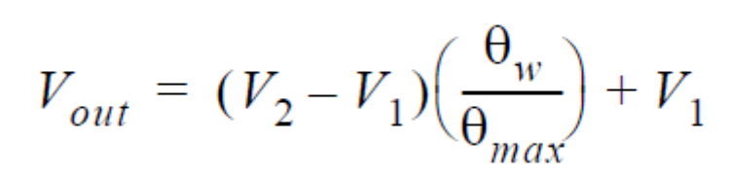
Potentiometer (position sensor)
Potentiometer: produces a voltage proportional to distance from a reference point
Since there is a sliding mechanical contact, noise, dirt, humidity, and mechanical wear limit precision.

Slide 6
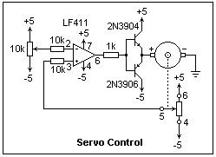
Simple servo control with Potentiometer (Position tracking)

Slide 7
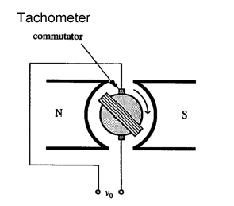
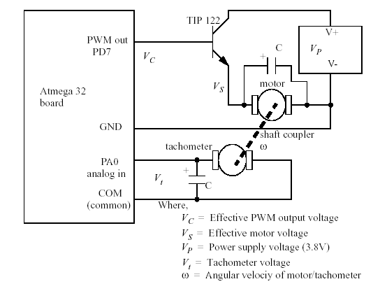
Another common technique uses a simple permanent magnet DC generator (note:you can also use a small DC motor). The generator is hooked to the rotating shaft. The rotation of a shaft will induce a voltage proportional to the angular velocity.
At low velocities S/N ratio is poor, and it is difficult to determine when velocity is zero

Slide 8
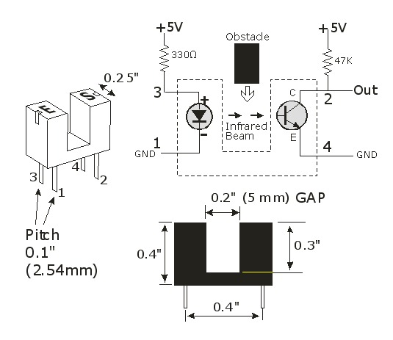
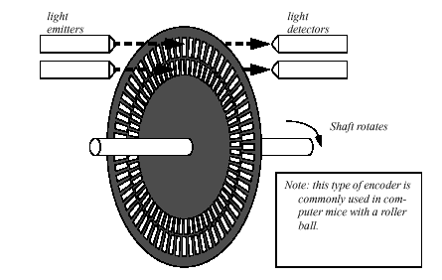
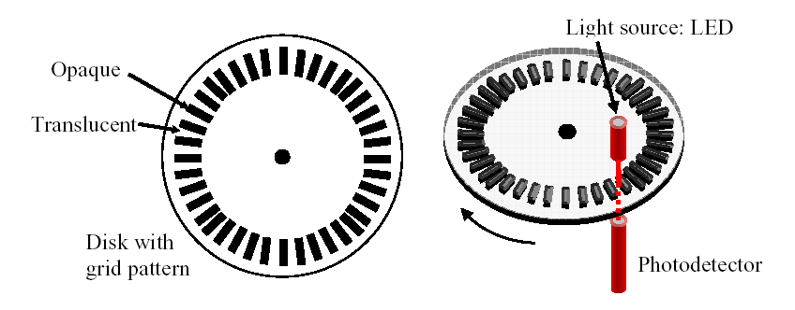

Slide 9
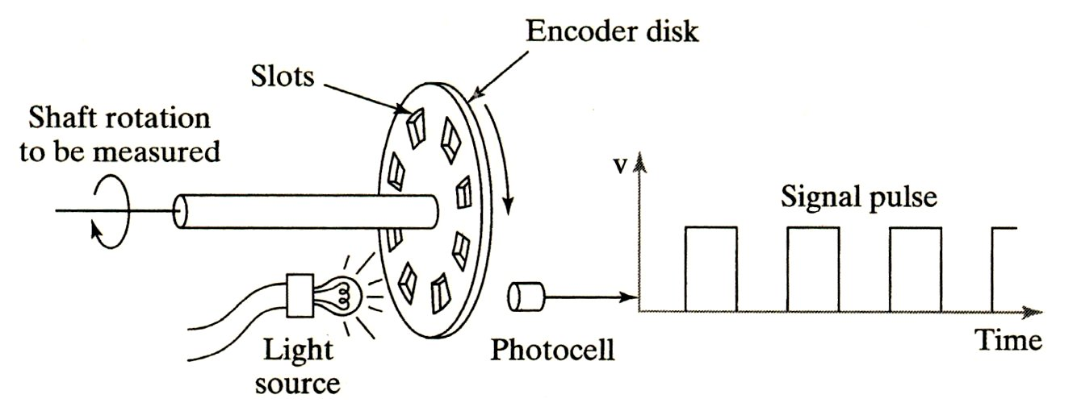
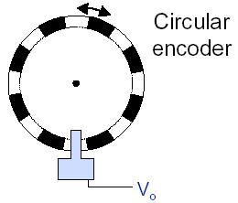
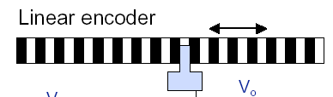
Optical Encoders: Motion is detected by electronically counting pulses of light.
optical devices to measure angular displacement and angular velocity
Incremental encoders: gives change in position (Artımlı Tip)
Absolute encoders: gives actual position (gray or binary)

Slide 10
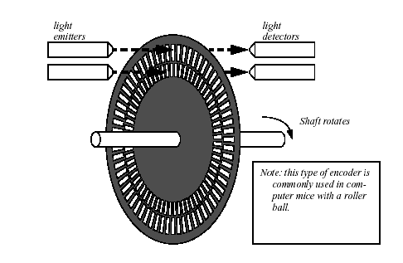
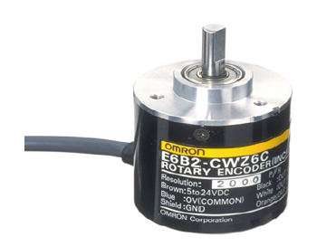
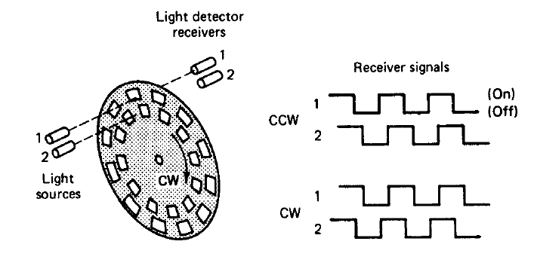
Incremental Encoder (Artımlı Tip)
the distance of rotation is determined by counting the pulses from one of the rings.
An Encoder Disk
Incremental
encoder with two track (quadrature encoder

Slide 11
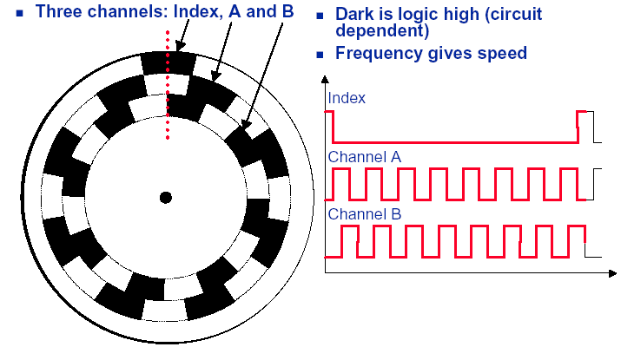
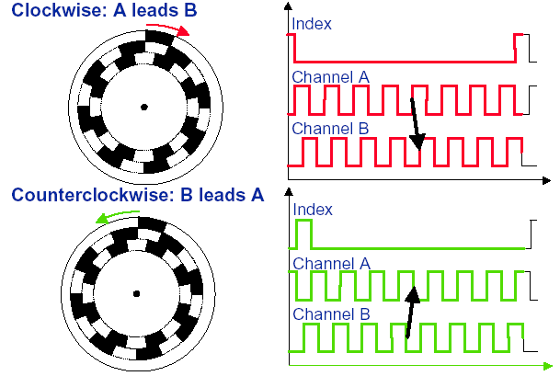
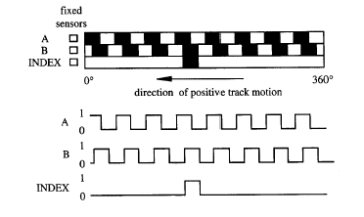
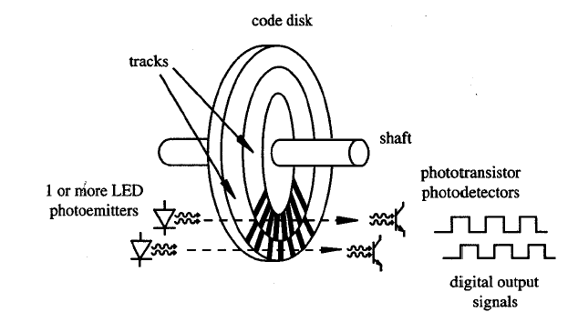
Incremental Encoder ( quadrature encoder )

Slide 12
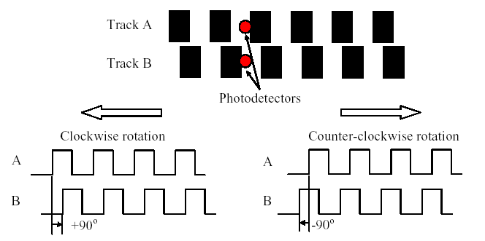
Incremental encoder with two track
Distance and direction:

Slide 13
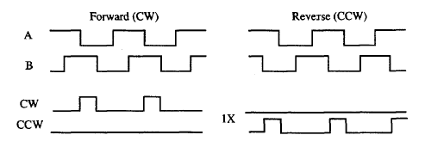
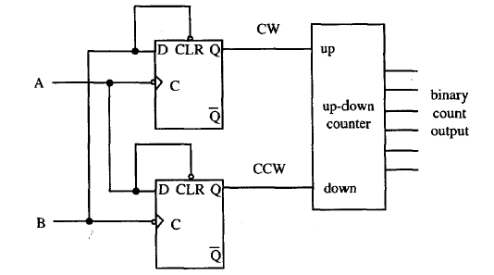
Incremental Encoder

Slide 14
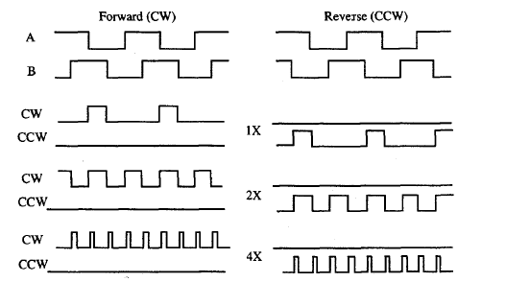

Slide 15
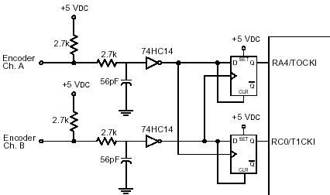
Another application of encoder decoding by flip/flop interface to microcontroller (external hardware):

Slide 16
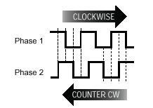
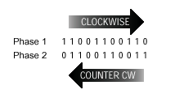
Sequence of two-bit numbers output by the phases of a rotary encoder.
CW(01,00,10,11)
CCW (01,11,10,00).

Slide 17
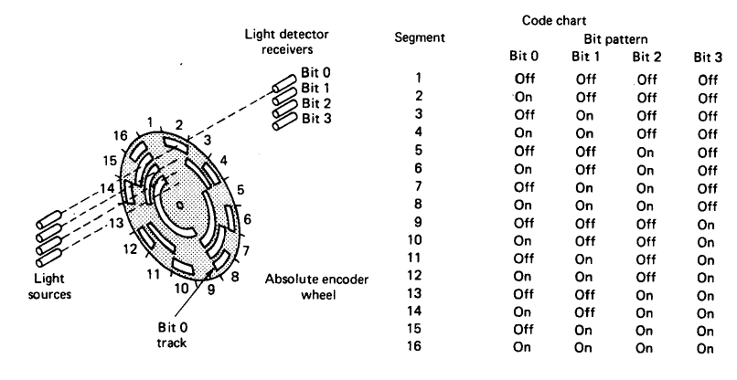
Absolute Optical Encoders

Slide 18
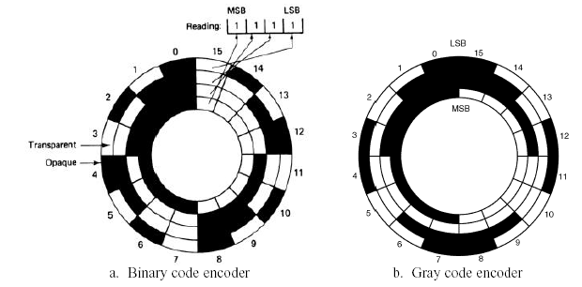
Absolute Optical Encoders (Binary/Gray)

Slide 19
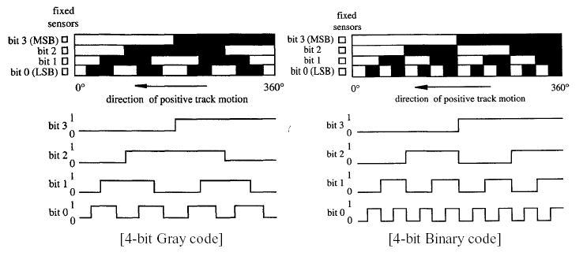
Absolute Optical Encoders

Slide 20
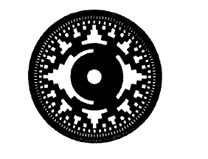
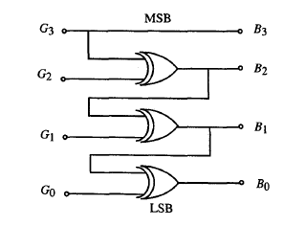
Absolute Optical Encoders gray code
Gray code to binary

Slide 21

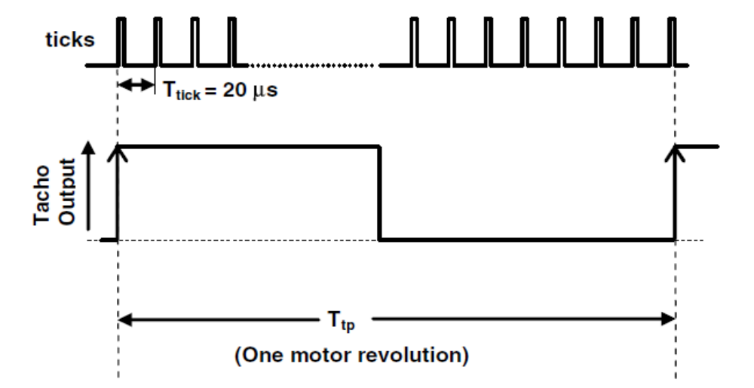
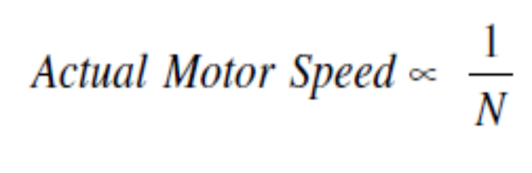
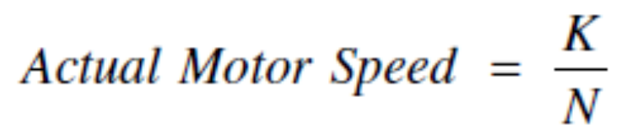
Measuring Actual Motor Speed: simple method
Single pulse
encoder
Use a Timer in auto-reload mode to generate the software interrupts (ticks) at 20 μSec interval.
Calculate the Timer 1 reload value for a System Clock of 22.1184 MHz.
N: number of ticks counted for one motor revolution
K is the proportionality constant

Slide 22
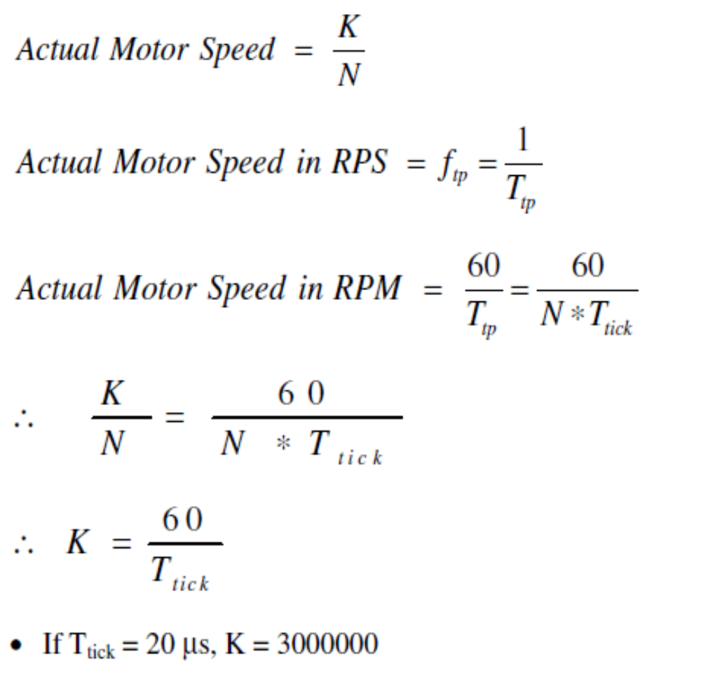
For every tick, increment a counter (let us call it TACHO_counter). This can be done in the ISR of Timer 1.
Use the Tacho encoder pulse to generate an external hardware interrupt at /INT0.

Slide 23
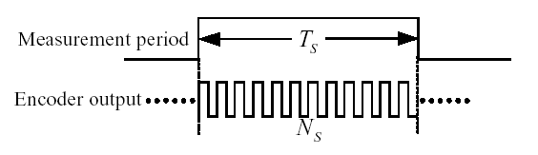
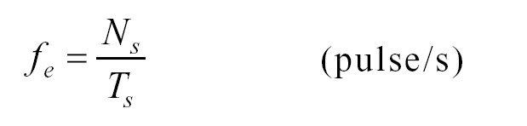

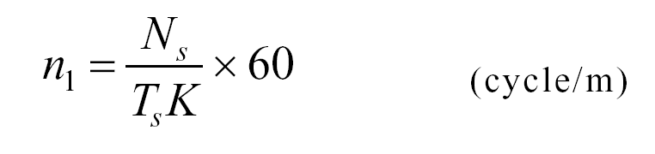
Multi –pulse
encoder
T _{S}：the measurement period,
N_{s}：Output pulse number of the encoder in the measurement period
The frequency of output pulse of the encoder is:
Assume that the output pulse number one cycle of the encoder is K (pulse/cycle), the motor speed can be expressed as
motor speed can be expressed as

Slide 24
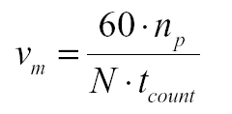
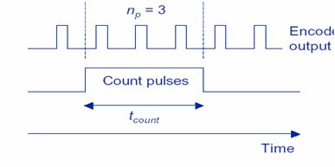
Method 2 ( Pulse Number Measurement)
Use timer in counting mode
Count the number of encoder pulses during a fixed time interval
Number of counted pulses is directly proportional to rotational speed
Resolution = 1 / ( tcount • N • vm )
N = encoder counts per rev.
np = number of pulses counted
vm = motor speed in rpm
tcount = duration of counting interval

Slide 25
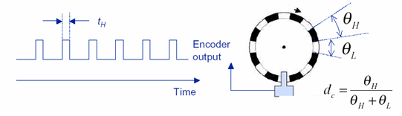
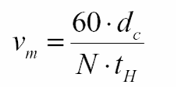
Measuring Shaft Speed (Method 1)
Measuring Shaft Speed by using simple relative optic encoder
N = encoder counts per rev.
dc = duty cycle of encoder signal
vm = motor speed in rpm

Slide 26
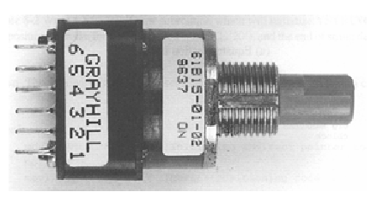
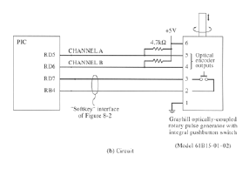
Rotary Pulse Generator (RPG) or Digital potentiometer
In digital systems, use of a potentiometer would require an A/D to convert the signal from the potentiometer. It would be better to have the control to be fully digital. One such method is through the use of a Rotary Pulse Generator (RPG).The internal structure of RPG is like encoder.

Slide 27


Mechanical RPG
Four cycles per
revolution
16 state changes
per revolution
Mechanical wipers
with contact bounce
Pattern
Optical RPG
16, 32, 64, or 120 state changes per revolution
LED bounces light off reflective surface and onto photo
detector
Much more costly than Mechanical RPG

Slide 28


Slide 29

RPG Cycles
RPGs usually have two outputs labeled A and B.
As the RPG is turned continuously in one direction a 2-bit Gray code is observed:
… → 00 → 01 → 11 → 10 → 00 → …
As the RPG is turned continuously in the opposite direction the reverse is observed:
… ← 00 ← 01 ← 11 ← 10 ← 00 ← …

